Slide 1

COMP409: Compiler Design 3. Syntax Analysis
Instructor: Sushil Nepal, Assistant Professor
Block: 9-308
Email: sushilnepal@ku.edu.np
Contact: 9851-151617
Kathmandu University
Department of Computer Science and Engineering

Slide 2
Introduction
All programming languages have certain syntactic structures
We need to verify that the source code written for a language is syntactically valid
The validity of the syntax is checked by the syntax analysis
Syntaxes are represented using context free grammar (CFG), or Backus Naur Form (BNF)
Parsing is the act of performing syntax analysis to verify an input program's compliance with the source language

Slide 3
Introduction
The purpose of syntax analysis or parsing is to check that we have a valid sequence of tokens
A by-product of this process is typically a tree that represents the structure of the program
Parsing is the act of checking whether a grammar “accepts” an input text as valid (according to the grammar rules)
It determines the exact correspondence between the text and the rules of given grammar

Slide 4
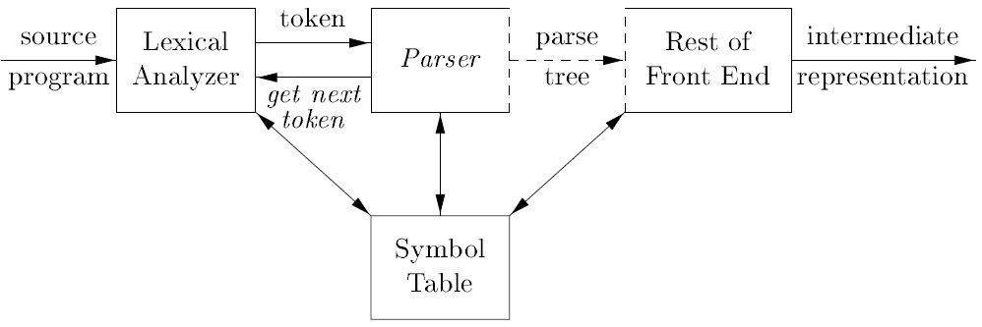
The Role of the Parser

Slide 5
The Role of the Parser
Analyzes the context free syntax
Generates the parse tree
Determines errors and tries to handle them

Slide 6
Types of Parser
There are three general types of parsers for grammars: universal, top-down and bottom-up
Universal Parser
Can parse any kind of grammars
Too inefficient to use in production compilers
E.g. of universal parsing methods: CYK algorithm, Earley’s algorithm
The methods commonly used in compilers can be classified as being either top-down or bottom-up

Slide 7
Types of Parser
Top-Down Parser
the parse tree is created top to bottom, starting from the root
LL for top-down parsing
Bottom-Up Parser
the parse is created bottom to top; starting from the leaves
LR for bottom-up parsing

Slide 8
Types of Parser
Both top-down and bottom-up parsers scan the input from left to right (one symbol at a time)
Efficient top-down and bottom-up parsers can only be implemented for sub-classes of context-free grammars

Slide 9
Error Handling
Every phase of the compiler is prone to errors
Syntax analysis and semantic analysis are the phases that are the most common sources of errors
Syntactic errors include misplaced semicolons or extra or missing braces; that is, “{”or “}”
As another example, in C or Java, the appearance of a case statement without an enclosing switch is a syntactic error
If error occurs, the process should not terminate but instead report the error and try to advance

Slide 10
Error Recovery Techniques
Panic Mode Recovery
With this method, on discovering an error, the parser discards input symbols one at a time until one of a designated set of synchronizing tokens is found, say a semicolon
May skip errors if there are more than one error in the sentence
It has the advantage of simplicity, and, unlike some methods, is guaranteed not to go into an infinite loop

Slide 11
Error Recovery Techniques
Phrase-Level Recovery
On discovering an error, a parser may perform local correction on the remaining input; that is, it may replace a prefix of the remaining input by some string that allows the parser to continue
A typical local correction is to replace a comma by a semicolon, delete an extraneous semicolon, or insert a missing semicolon

Slide 12
Error Recovery Techniques
Error Productions
By anticipating common errors that might be encountered, we can augment the grammar for the language at hand with productions that generate the erroneous constructs
A parser constructed from a grammar augmented by these error productions detects the anticipated errors when an error production is used during parsing
The parser can then generate appropriate error diagnostics about the erroneous construct that has been recognized in the input

Slide 13
Error Recovery Techniques
Global Correction
We would like a compiler to make as few changes as possible in processing an incorrect input string
There are algorithms for choosing a minimal sequence of changes to obtain a globally least-cost correction
Given an incorrect input string X and grammar G, these algorithms will find a parse tree for a related string Y, such that the number of insertions, deletions, and changes of tokens required to transform X into Y is as small as possible

Slide 14
Error Recovery Techniques
Unfortunately, these methods are in general too costly to implement in terms of time and space, so these techniques are currently only of theoretical interest

Slide 15
Context Free Grammar
Most of the programming languages have recursive structures that can be defined by Context Free Grammar (CFG)
CFG can be defined as 4 – tuple (V, T, P, S), where
V → finite set of Variables or Non-terminals that are used to define the grammar denoting the combination of terminal or non-terminals or both
T → Terminals, the basic symbols of the sentences; they are indivisible units
P → Production rule that defines the combination of terminals or non-terminals or both for particular non-terminal
S → It is the special non-terminal symbol called start symbol

Slide 16
Example: Grammar to define a palindrome string over binary string S → 0S0 | 1S1
S → 0 |1
Example: Grammar to define an infix expression E → E A E | (E) | -E | id
A → + | - | * | / | ^
E and A are non terminals and E as start symbol. Remaining are non terminals.

Slide 17
Notational Conventions
Lowercase letters, symbols (like operators), bold string are used for denoting terminals. Eg :- a, b, c, 0, 1 ∈ T
Uppercase letters, italicized strings are used for denoting non-terminals. Eg :- A, S, B, C ∈ V
Lowercase Greek letters (α, β, γ, δ) are used to denote the terminal, non-terminal or combination of both
Production of the form A → a |b, is read as “A produces a or b”

Slide 18
Derivations
Verification of a sentence defined by the grammar is done using production rules to obtain the particular sentence by expansion of non-terminals
This process is known as a derivation
E ⇒ E+E means E+E derives from E
we can replace E by E+E
to able to do this, we have to have a production rule E→ E+E in our grammar
E ⇒ E+E ⇒ id+E ⇒ id+id
A sequence of replacements of non-terminal symbols is called a derivation of id+id from E

Slide 19
Derivations
The term α ⇒ β is used to denote that β can be derived from α
Similarly, α ⇒* β denotes derivation using zero or more rules and α ⇒⁺ β denotes derivation using one or more rules
L(G) is the language of G (the language generated by G) which is a set of sentences
A sentence of L(G) is a string of terminal symbols of G

Slide 20
Derivations
If S is a start symbol of G then, w is a sentence of L(G) if and only if S ⇒* w, where w is a string of terminals of G
If G is a context free grammar, then L(G) is a context free language
Two grammars are equivalent if they produce the same language
For S ⇒ α
If α is a combination of terminals and non-terminals, it is called as a sentential form of G
If α contains terminals only, it is called as a sentence of G

Slide 21
Derivations
If we always choose the left-most non-terminal in each derivation step, this derivation is called left-most derivation
If we always choose the right-most non-terminal in each derivation step, this derivation is called right-most derivation

Slide 22
Example:
Consider a grammar G (V, T, P, S), where
V → {E}
T → {+, *, -, (, ), id}
P → {E → E + E, E → E * E, E → (E), E → -E, E → id } S→ {E}
For id * id + id,
E ⇒ E * E ⇒ id * E ⇒ id * E + E ⇒ id * id + E ⇒ id * id + id
This is left-most derivation

Slide 23
Parse Tree
The pictorial representation of the derivation can be depicted using the parse tree
In parse tree internal nodes represent non-terminals and the leaves represent terminals
Consider the grammar above:
E → E + E | E * E | (E) | -E | id
The string -(id + id) is a sentence of this grammar because there is a derivation:
E ⇒ -E ⇒ -(E) ⇒ -(E + E) ⇒ -(id + E) ⇒ -(id + id)

Slide 24
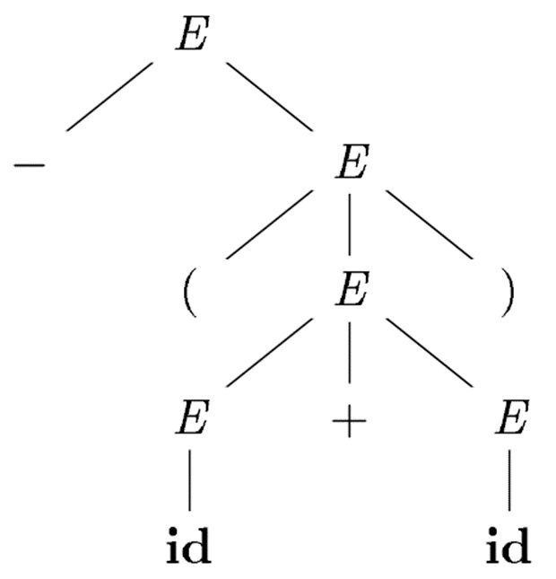
Parse Tree
Parse tree for:
-(id + id)

Slide 25
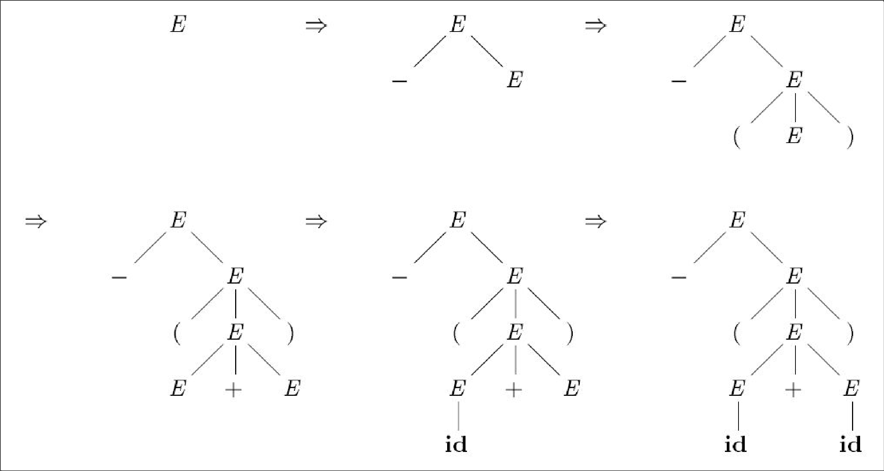
Sequence of parse trees for the derivation

Slide 26
Ambiguity
A grammar is said to be ambiguous if it can produce a sentence in more than one way
If there is more than one parse tree for a sentence or derivation (left or right) with respect to the given grammar, then the grammar is said to be ambiguous

Slide 27
Ambiguity
Consider the grammar above:
E → E + E | E * E | (E) | -E | id
Consider the string: id + id * id
It has two distinct derivations:
E ⇒ E+E ⇒ id+E ⇒ id+E*E ⇒ id+id*E ⇒ id+id*id
E ⇒ E*E ⇒ E+E*E ⇒ id+E*E ⇒ id+id*E ⇒ id+id*id
So, this grammar is ambiguous

Slide 28
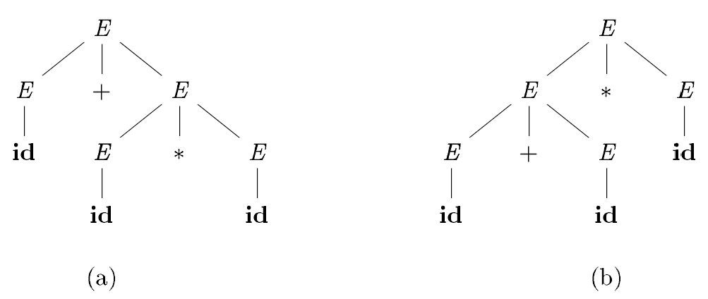
Ambiguity

Slide 29
Left Recursion
The grammar with recursive non-terminal at the left of the production is called left recursive grammar
A grammar is left recursive if it has a non – terminal “A” such that there is a derivation, A ⇒⁺ Aα for some string α
Eg:
E → E + T | T
T → T * F | F
F → id | (E)

Slide 30
Left Recursion
Left recursion causes recursive descent parser to go into infinite loop
Top down parsing techniques cannot handle left recursive grammars
So, we have to convert our left recursive grammar into one which is not left recursive
The left recursion may appear in a single derivation(called immediate left recursion), or may appear in more than one step of the derivation

Slide 31
Left Recursion
Example of non immediate left recursion:
S → Aab | c
A → Sc |c
This grammar is not immediately left recursive, but it is still left recursive
For instance, S ⇒ Aab ⇒ Scab causes left recursion

Slide 32
Removing Left Recursion
If we have a grammar of the form A → Aα | β, the rule for removing left recursion is
A → βA'
A' → αA' | ε
This is the equivalent non-recursive grammar

Slide 33
Removing Left Recursion
Any immediate left-recursion can be eliminated by generalizing the above
For a group of productions of the form:
A → Aα₁| Aα₂|…| Aα_{n}| β₁ | β₂ | …| β_{m}
we replace the A-production by
A → β₁A'| β₂A'|…|β_{m}A'
A' → α₁A'| α₂A'|…| α_{n}A'|ε

Slide 34
Removing Left Recursion
Algorithm:
(Note that the resulting non-left-recursive grammar may have ε–productions)
Input → Grammar G
Output → Equivalent grammar with no left recursion

Slide 35
Arrange non terminals in some order A₁, A₂, ……., A_{n}
for i=1 to n do
for j=1 to i-1 do
replace each production of the form A_{i} → A_{j} γ by the productions A_{i} → α₁ γ |…..| α_{k} γ,
where A_{j} → α₁|…..| α_{k} are all current A_{j}-productions
end do
eliminate the immediate left recursions among A_{i}-productions
end do

Slide 36
Example
S → Aa | b
A → Ac | Sd | ε
We order the non terminals S, A. There is no immediate left
recursion among the S-productions, so nothing happens
during the outer loop for i = 1.
For i = 2, we substitute for S in A → Sd Replace A → Sd with A → Aad | bd Then we have, A → Ac | Aad | bd | ε

Slide 37
Now, remove the immediate left recursions
A → bdA' | εA'
A’ → cA' | adA' | ε
So, the resulting equivalent grammar with no left recursion is
S → Aa | b
A → bdA' | A'
A' → cA' | adA' | ε

Slide 38
Left Factoring
Left factoring is a grammar transformation that is useful for producing a grammar suitable for predictive, or top-down, parsing
When the choice between two alternative A-productions is not clear, we may be able to rewrite the productions to defer the decision until enough of the input has been seen that we can make the right choice

Slide 39
Left Factoring
For example, if we have the two productions
Stmt → if Expr then Stmt else Stmt | if Expr then Stmt
On seeing the input if, we cannot immediately tell which production to choose to expand stmt
In general, if A → αβ₁ |αβ₂ are two A-productions, and the input begins with a nonempty string derived from α, we do not know whether to expand A to αβ₁ or αβ₂

Slide 40
Left Factoring
However, we may defer the decision by expanding A to A'
Then, after seeing the input derived from α, we expand A' to β₁ or β₂
That is, left-factored, the original productions become A → α A'
A' → β₁ | β₂

Slide 41
Algorithm: Left factoring a grammar
INPUT: Grammar G
OUTPUT: An equivalent left-factored grammar
METHOD: For each nonterminal A, find the longest prefix α common to two or more of its alternatives.
If α ≠ ε, replace all of the A-productions A → α β₁ | α β₂ |….| α β_{n} |γ, where γ represents all alternatives that do not begin with α, by
A → α A' | γ
A' → β₁ | β₂ |….| β_{n}
Here A' is a new nonterminal. Repeatedly apply this transformation until no two alternatives for a nonterminal have a common prefix.

Slide 42
Example: The “dangling-else” problem:
S → i E t S | i E t S e S | a
E → b
Here, i, t, and e stand for if, then, and else; E and S stand for “conditional expression” and “statement”
Left-factored, this grammar becomes:
S → i E t S S' | a
S' → e S | ε
E → b
Thus, we may expand S to iEtSS' on input i, and wait until iEtS has been seen to decide whether to expand S' to eS or to ε

Slide 43
Parsing
Given a stream of input tokens, parsing involves the process of “reducing” them to a non-terminal
The input string is said to represent the non-terminal it was reduced to
Parsing can be either top-down or bottom-up
Top-down parsing involves generating the string starting from the first non-terminal and repeatedly applying production rules.
Bottom-up parsing involves repeatedly rewriting the input string until it ends up in the first non-terminal of the grammar.

Slide 44
Top-Down Parsing
Top-down parsing can be viewed as the problem of constructing a parse tree for the input string, starting from the root and creating the nodes of the parse tree in preorder
Top-down parsing can be viewed as finding a leftmost derivation for an input string
Starting at the start non-terminal symbol, the use of production rules leads to the input string

Slide 45
Top-Down Parsing
At each step of a top-down parse, the key problem is that of determining the production to be applied for a nonterminal, say A
Once an A-production is chosen, the rest of the parsing process consists of “matching” the terminal symbols in the production body with the input string

Slide 46
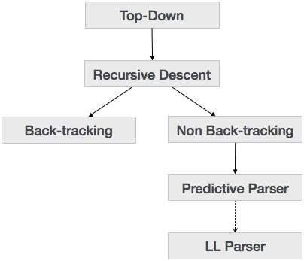
Top-Down Parsing

Slide 47
Recursive-Descent Parsing
A recursive-descent parsing program consists of a set of procedures, one for each nonterminal
Recursive-descent parser may require backtracking to find the correct A-production to be applied
Start with the starting non-terminal and use the first production, verify with input and if there is no match, backtrack and apply another rule
Backtracking is rarely needed to parse programming language constructs, so backtracking parsers are not seen frequently

Slide 48
Recursive-Descent Parsing
Consider the grammar
S → cAd A → ab|a
To construct a parse tree top-down for the input string w = cad, begin with a tree consisting of a single node labeled S, and the input pointer pointing to c, the first symbol of w

Slide 49
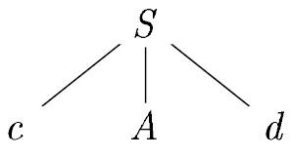
S has only one production, so we use it to expand S and obtain the following tree:
The leftmost leaf, labeled c, matches the first symbol of input w, so we advance the input pointer to a, the second symbol of w, and consider the next leaf, labeled A
Now, we expand A using the first alternative A → ab to obtain the subsequent tree

Slide 50
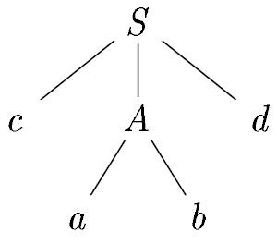
We have a match for the second input symbol, a, so we advance the input pointer to d, the third input symbol, and compare d against the next leaf, labeled b
Since b does not match d, we report failure and go back to A to see whether there is another alternative for A that has not been tried, but that might produce a match

Slide 51
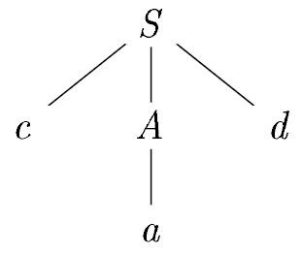
In going back to A, we must reset the input pointer to position 2, the position it had when we first came to A
The second alternative for A produces the following tree:
The leaf ‘a’ matches the second symbol of w and the leaf d matches the third symbol
Since we have produced a parse tree for w, we halt and announce successful completion of parsing

Slide 52
Recursive-Descent Parsing
A left-recursive grammar can cause a recursive-descent parser, even one with backtracking, to go into an infinite loop
That is, when we try to expand a nonterminal A, we may eventually find ourselves again trying to expand A without having consumed any input

Slide 53
Algorithm:
Use two pointers: iptr for pointing the input symbol to be read and optr for pointing the symbol of output string, initially start symbol S.
If the symbol pointed by optr is a non-terminal, use the first unexpanded production rule for expansion.
While the symbol pointed by iptr and optr is same increment the both pointers.
The loop in the above step terminates when
there is a non-terminal at the output (case A)
it is the end of input (case B)
unmatching terminal symbol pointed by iptr and optr is seen (case C)

Slide 54
If (A) is true, goto step 2
If (B) is true, terminate with success
If (C) is true, decrement both pointers to the place of last non-terminal expansion(backtrack) and goto step 2
If there is no more unexpanded production left and (B) is not true, report error

Slide 55
Example: Consider a grammar: S → cAd A → ab|a Input string is “cad” | Input | Output | Rules Fired
 | (iptr)cad | (optr)S | [Rule 2, Try S → cAd ]
 | (iptr)cad | (optr)cAd | [Rule 3, Match c]
 | c(iptr)ad | c(optr)Ad | [Rule 5, Try A → ab]
 | c(iptr)ad | c(optr)abd | [Rule 3, Match a]
 | ca(iptr)d | ca(optr)bd | [Rule 7, dead end, backtrack]
 | c(iptr)ad | c(optr)Ad | [Rule 5, Try A → a]
 | c(iptr)ad | c(optr)ad | [Rule 3, Match a]
 | ca(iptr)d | ca(optr)d | [Rule 3, Match d]
 | cad(iptr) | cad(optr) | [Rule 6, Terminate with success]

Slide 56
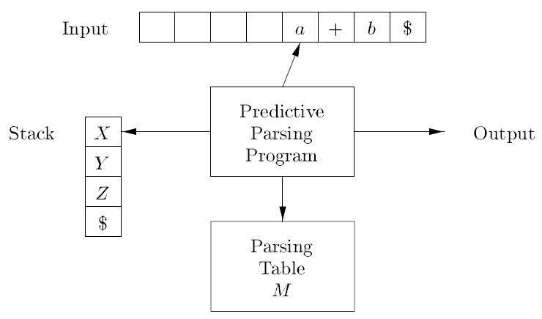
Nonrecursive Predictive Parsing

Slide 57
FIRST and FOLLOW
The construction of both top-down and bottom-up parsers is aided by two functions, FIRST and FOLLOW, associated with a grammar G
During top-down parsing, FIRST and FOLLOW allow us to choose which production to apply, based on the next input symbol

Slide 58
FIRST(α) is a set of the terminal symbols which occur as first symbols in strings derived from α where α is any string of grammar symbols
if α ⇒* ε i.e., α derives to ε, then ε is also in FIRST(α)
FOLLOW(A) is the set of the terminals which occur immediately after(follow) the non-terminal A in the strings derived from the starting symbol
a terminal a is in FOLLOW(A) if S ⇒* αAaβ
$ is in FOLLOW(A) if S ⇒ αA (i.e., if A can be the last symbol in a sentential form)

Slide 59
Computing FIRST [FIRST(α) = {the set of terminals that begin all strings derived from α}]
If X is ε then FIRST(X)={ε}
If X is a terminal symbol then FIRST(X) = {X}
If X is a non-terminal symbol and X → ε is a production rule then FIRST(X)=FIRST(X) ∪ ε
If X is a non-terminal symbol and X → Y₁Y₂ …Y_{n} is a production rule then
if a terminal a is in FIRST(Y₁) then FIRST(X) = FIRST(X) ∪ a
if a terminal a is in FIRST(Y_{i}) and ε is in all FIRST(Y_{j}) for j=1,...,i-1 then FIRST(X) = FIRST(X) ∪ a
if ε is in all FIRST(Y_{j}) for j=1,...,n then FIRST(X) = FIRST(X) ∪ ε

Slide 60
Now, we can compute FIRST for any string X₁X₂…X_{n} as follows:
Add to FIRST(X₁X₂…X_{n}) all non-ε symbols of FIRST(X₁)
Also add the non-ε symbols of FIRST(X₂), if ε is in FIRST(X₁); the non-ε symbols of FIRST(X₃), if ε is in FIRST(X₁) and FIRST(X₂); and so on
Finally, add ε to FIRST(X₁X₂…X_{n}) if, for all i, ε is in FIRST(X_{i})

Slide 61
Computing FOLLOW [FOLLOW(A) = {the set of terminals that can immediately follow non-terminal A}]
Place $ in FOLLOW(S), where S is the start symbol, and $ is the input right endmarker
For every production B → αAβ, where α and β are any strings of grammar symbols and A is non-terminal, then everything in FIRST(β) except ε is placed on FOLLOW(A)
For every production B → αA, or a production B → αAβ, where FIRST(β) contains ε (i.e. β is nullable), then everything in FOLLOW(B) is added to FOLLOW(A)

Slide 62
E → TE' | FIRST(F) = {( , id} | FIRST(TE') = {( , id}
E' → +TE' | ε | FIRST(T') = {* , ε} | FIRST(+TE') = {+}
T → FT' | FIRST(T) = {( , id} | FIRST(FT') = {( , id}
T' → *FT' | ε | FIRST(E') = {+, ε} | FIRST(ε) = {ε}
F → (E) | id | FIRST(E) = {( , id} | FIRST(*FT') = {*}
Example 1: | FIRST( (E) ) = { ( } FIRST(id) = { id } | FOLLOW(E) = { $ , ) } FOLLOW(E') = { $ , ) } FOLLOW(T) = { +, ) , $ } FOLLOW(T') = { +, ) , $ } FOLLOW(F) = {+, *, ) , $ }

Slide 63
Example 2:
S → AB
A → Ca | ε
B → BaAC | c C → b | ε
Notice we have a left-recursive production that must be fix if we are to use LL(1) parsing:
B → BaAC |c
becomes
B → cB'
B' → aACB' | ε

Slide 64
Now the new grammar(G) is:
S → AB
A → Ca | ε
B → cB'
B' → aACB' | ε C → b | ε
It helps to first compute the nullable set (i.e., those non-terminals X that X⇒* ε), since you need to refer to the nullable status of various nonterminals when computing the first and follow sets:
nullable(G) = {A, B', C}

Slide 65
Predictive Parsing
A Recursive Descent parser always chooses the first available production whenever encountered by a non-terminal
This is inefficient and causes a lot of backtracking
It also suffers from the left-recursion problem
The recursive descent parser can work efficiently if there is no need of backtracking
A predictive parser tries to predict which production produces the least chances of a backtracking and infinite looping

Slide 66
Predictive Parsing
A predictive parser is characterized by its ability to choose the production to apply solely on the basis of the next input symbol and the current non-terminal being processed
To enable this, the grammar must take a particular form called a LL(1) grammar
The first "L" means we scan the input from left to right; the second "L" means we create a leftmost derivation; and the 1 means one input symbol of look ahead
LL(1) has no left recursive productions and is left-factored

Slide 67
LL(1) Grammars
Predictive parsers, that is, recursive-descent parsers needing no backtracking, can be constructed for a class of grammars called LL(1)
The predictive top-down techniques(either recursive-descent or table-driven) require a grammar that is LL(1)
One fully general way to determine if a grammar is LL(1) is to build the table and see if you have conflicts
A grammar whose parsing table has no multiple defined entries is said to be LL(1) grammar

Slide 68
Constructing LL(1) Parsing Table
for each production rule A → α of a grammar G for each terminal a in FIRST(α)
add A → α to [A,a] if ε in FIRST(α) then
for each terminal a in FOLLOW(A) add A → α to M[A,a]
if ε in FIRST(α) and $ in FOLLOW(A) then add A → α to M[A,$]
make all undefined entries of the parsing table M as error
Input: LL(1) Grammar G
Output: Parsing Table M

Slide 69
Example: Consider the grammar G:
E → TE' E' → +TE' | ε T → FT'
T' → *FT' | ε
F → (E) | id
FIRST(TE') = {(, id}
FIRST(+TE') = {+}
FIRST(ε) = { ε } FIRST(FT') = {(, id}
FIRST(*FT') = {*}
FIRST(ε) = { ε } FIRST((E)) = {(} FIRST(id) = {id}
FOLLOW(E) ={$, )}
FOLLOW(E') ={$, )}
FOLLOW(T) ={+, $, )}
FOLLOW(T') ={+, $, )}
FOLLOW(F) ={+, *, $, )}
FIRST(F) ={( , id}
FIRST(T') ={*, ε }
FIRST(T) ={( , id}
FIRST(E') ={+, ε }
FIRST(E) ={( , id}

Slide 70
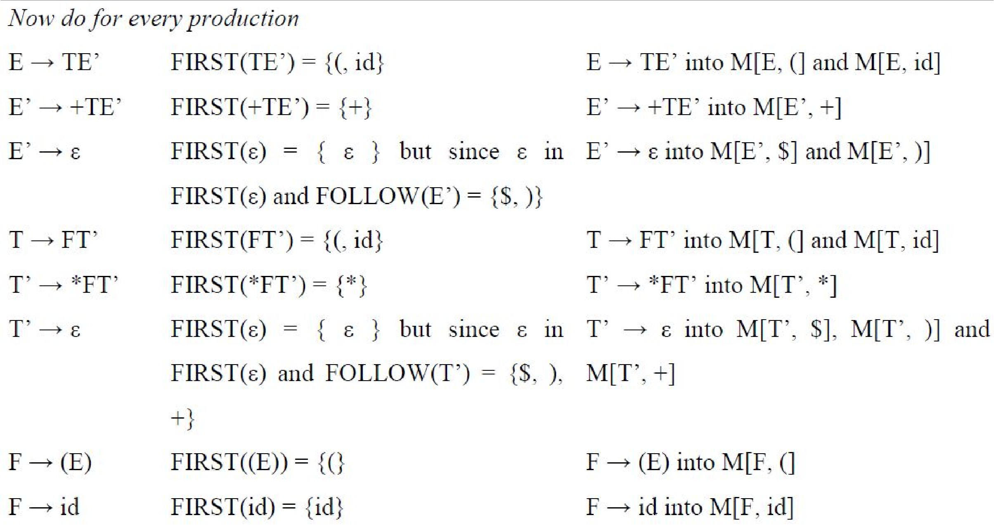

Slide 71
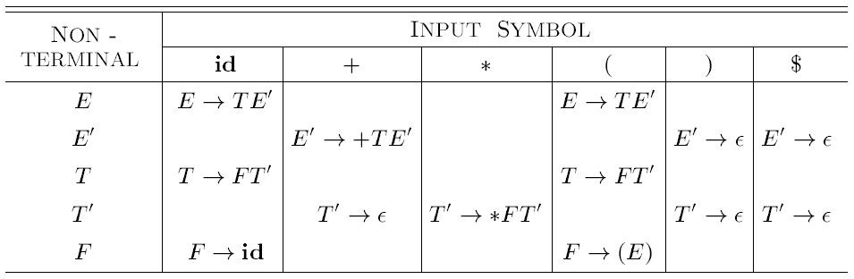
Final Parsing Table:

Slide 72
Nonrecursive Predictive Parsing
A nonrecursive predictive parser can be built by maintaining a stack explicitly, rather than implicitly via recursive calls
Non recursive predictive parsing is a table driven parser
The table driven predictive parser has stack, input buffer, parsing table and output stream
The input buffer contains the sentence to be parsed followed by $ as an end marker
The stack contains symbols of the grammar

Slide 73
Nonrecursive Predictive Parsing
Initially stack contains start symbol on top of $
When the stack is emptied (i.e. only $ is left in the stack), parsing is completed
Parsing table is two dimensional array M[A,a] containing information about the production to be used upon seeing the terminal at input and nonterminal at the stack
Each entry in the parsing table holds the production rule
Each column holds the terminal or $, and each row holds non terminal symbols

Slide 74
Nonrecursive Predictive Parsing
Algorithm:
INPUT: A string w and a parsing table M for grammar G.
OUTPUT: If w is in L(G), a leftmost derivation of w; otherwise, an error indication.
METHOD: Initially, the parser is in a configuration with w$ in the input buffer and the start symbol S of G on top of the stack, above $. The following algorithm uses the predictive parsing table M to produce a predictive parse for the input.

Slide 75
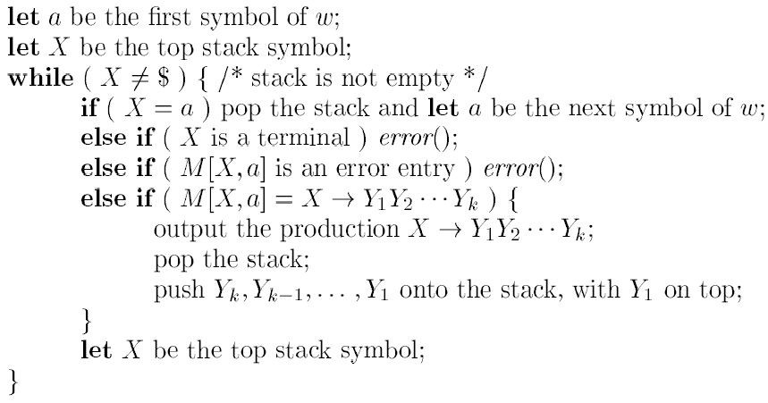

Slide 76
Nonrecursive Predictive Parsing
Example 1: Consider the grammar
E → TE'
E' → +TE' | ε
T → FT'
T' → *FT' | ε
F → (E) | id

Slide 77

Nonrecursive Predictive Parsing
Its Parsing Table is:

Slide 78
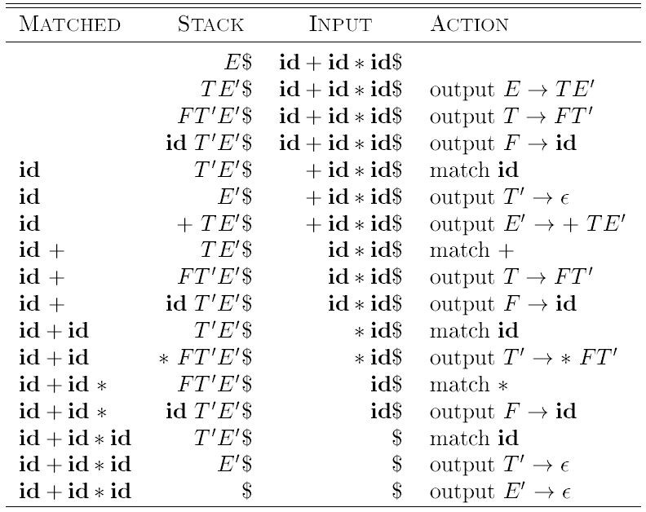
Moves made by a predictive parser on input
id + id * id

Slide 79
Example 2:
Consider the grammar
S → aBa
B → bB | ε
Parsing table will be:
 | a | b | $
S | S → aBa
B | B → ε | B → bB

Slide 80
Given string w = abba
 | Stack | Input | Action
 | $S | abba$ | output S → aBa
 | $aBa | abba$ | match a
 | $aB | bba$ | output B → bB
 | $aBb | bba$ | match b
 | $aB | ba$ | output B → bB
 | $aBb | ba$ | match b
 | $aB | a$ | output B → ε
 | $a | a$ | match a
 | $ | $ | Accept; Successful completion

Slide 81
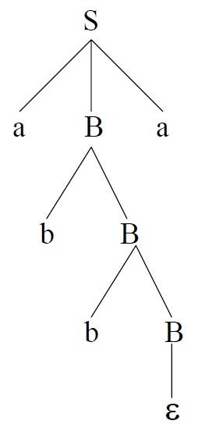
Output :-
S → aBa, B → bB, B → bB, B → ε
So, the leftmost derivation is
S ⇒ aBa ⇒ abBa ⇒ abbBa ⇒ abba
And the parse tree will be:

Slide 82
LL(1) Grammars
No ambiguous or left-recursive grammar is LL(1)
There are no general rules by which multiple-defined entries can be made single-valued without affecting the language recognized by a grammar(i.e. there are no general rules to convert a non LL(1) grammar into a LL(1) grammar)

Slide 83
Properties of LL(1) Grammar
No Ambiguity and No Recursion
In any LL(1) grammar, if there exists a rule of the form A → α | β , where α and β are distinct, then
For any terminal a, if a ∈ FIRST(α) then a ∉ FIRST(β) or vice-versa
Either α ⇒* ε or β ⇒* ε (or neither), but not both
If β ⇒* ε, then α does not derive any string beginning with a terminal in FOLLOW(A); likewise, if α ⇒* ε, then β does not derive any string beginning with a terminal in FOLLOW(A)

Slide 84
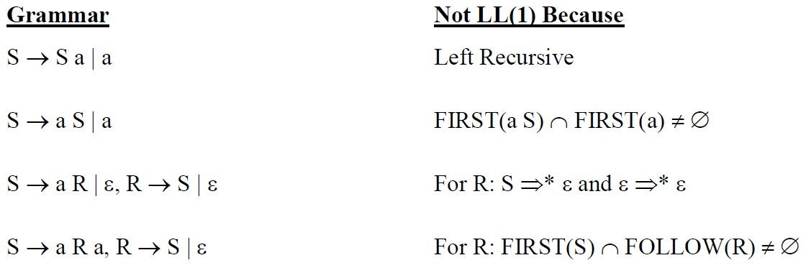
LL(1) Grammars

Slide 85
Error Recovery in Predictive Parsing
An error may occur in the predictive parsing due to following reasons
If the terminal symbol on the top of the stack does not match with the current input symbol
If the top of the stack is a non – terminal A, the current input symbol is a, and the entry for M[A, a] in parsing table is empty

Slide 86
What should the parser do in an error case?
A parser should try to determine that an error has occurred as soon as possible. Waiting too long before declaring an error can cause the parser to lose the actual location of the error.
A suitable and comprehensive message should be reported.
After an error has occurred, the parser must pick a reasonable place to resume the parse. Rather than giving up at the first problem, a parser should always try to parse as much of the code as possible in order to find as many real errors as possible during a single run.

